Slide 1
Coded Extraction Plugins
Day 4 - Chapter 2

Slide 2
Extraction plugin
Sample Example code is here
https://msdn.microsoft.com/en-us/library/ms243179(v=vs.140).aspx

Slide 3
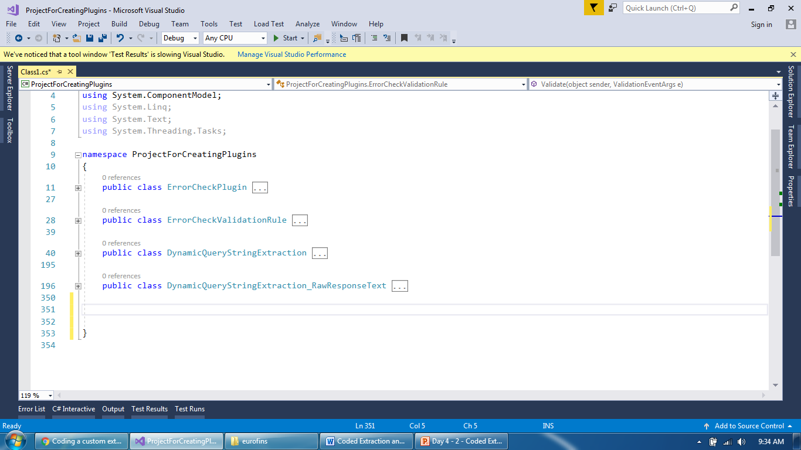
Extraction plugin
Add a new class and extend a base class for ExtractionRule

Slide 4
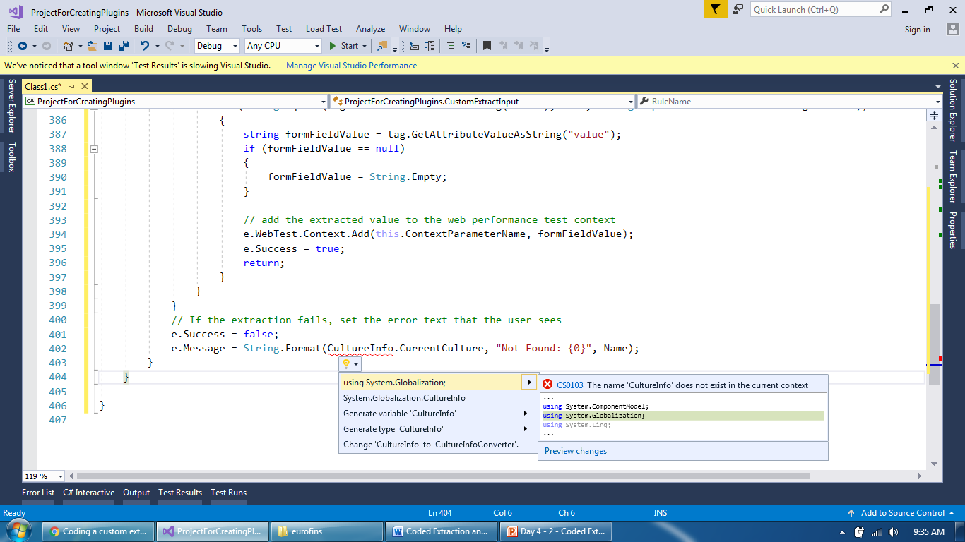
Extraction plugin
Correct all the errors or warnings

Slide 5
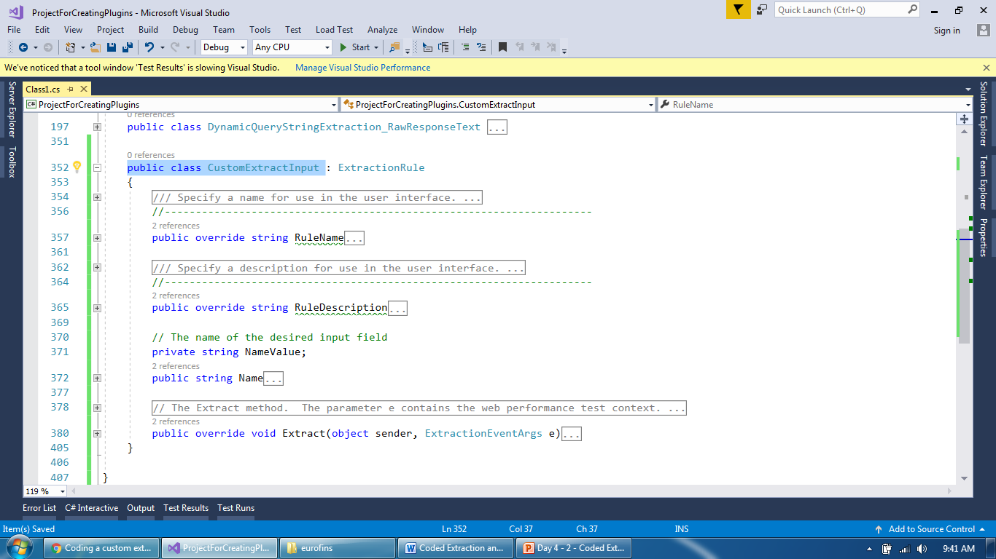
Extraction plugin
Add a code here and all classes will look like this

Slide 6
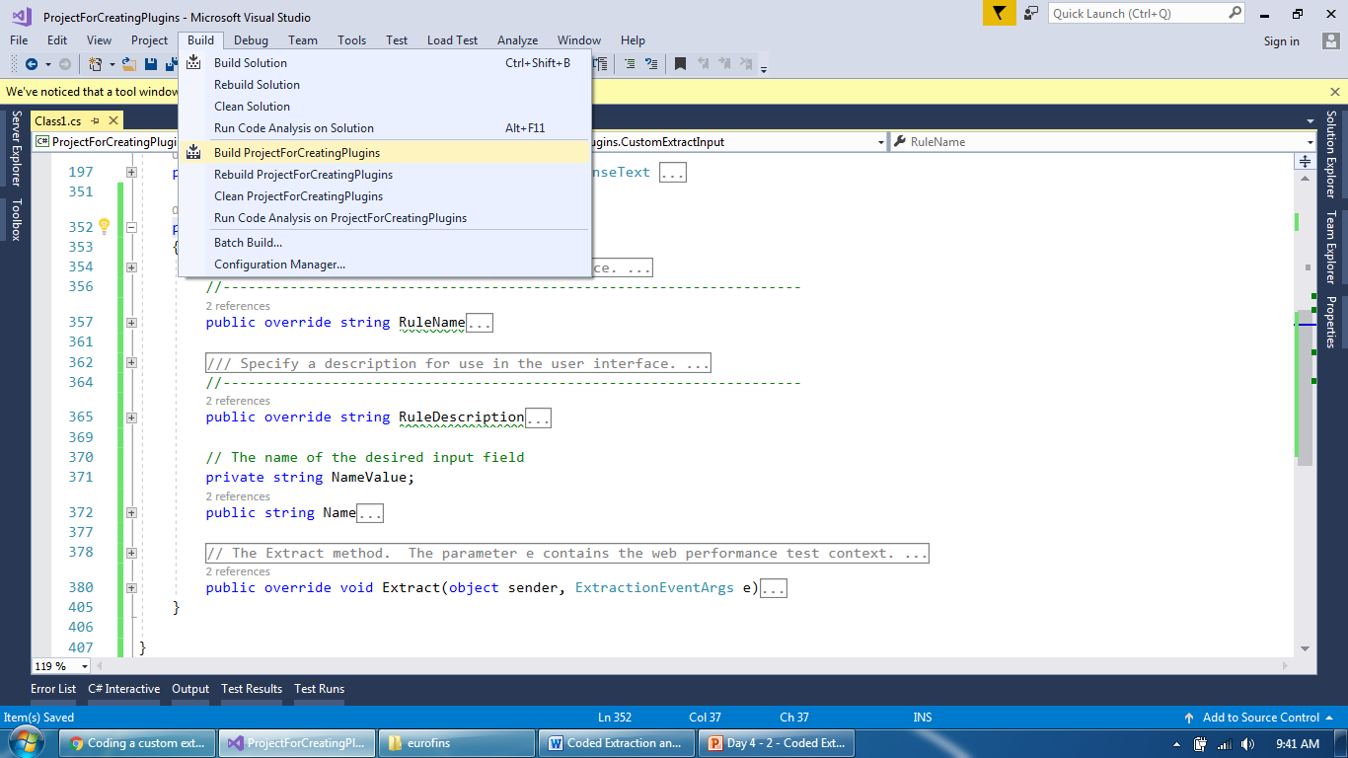
Extraction plugin
Build the project to create a DLL

Slide 7
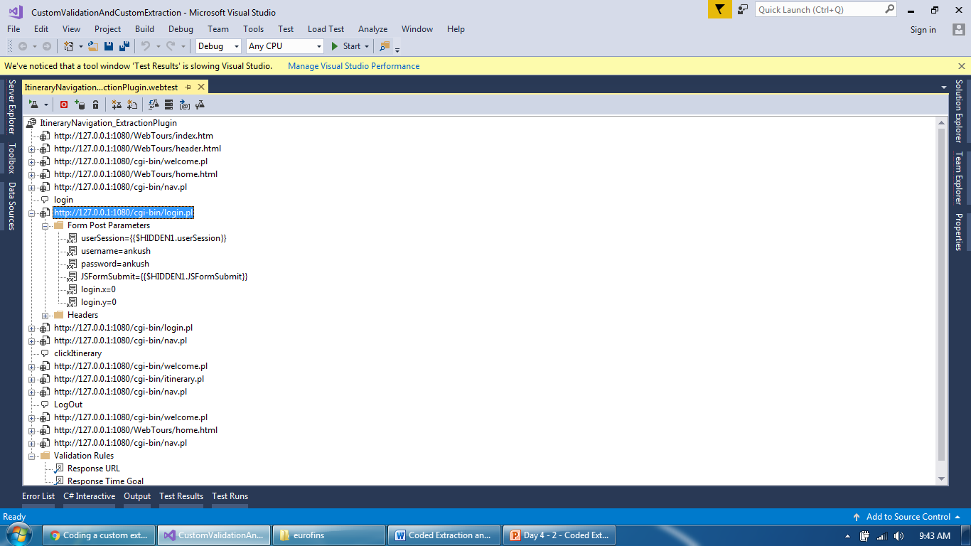
Extraction plugin
Identify request having input tag (e.g. username password)

Slide 8
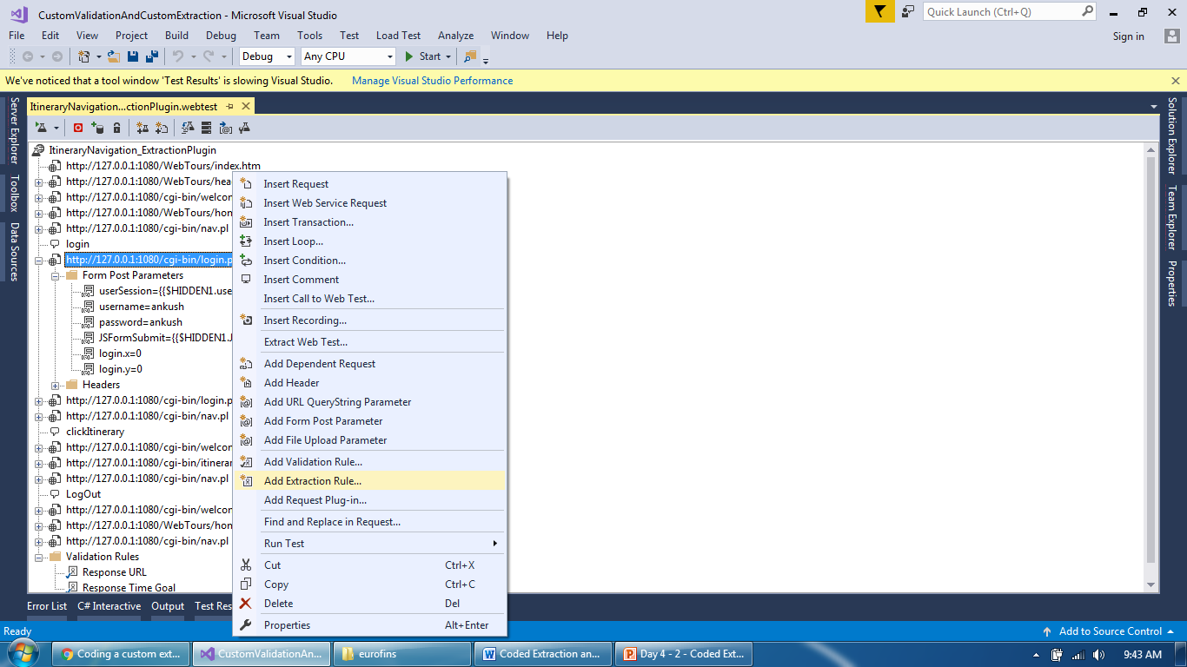
Extraction plugin
Add a Extraction rule created recently

Slide 9
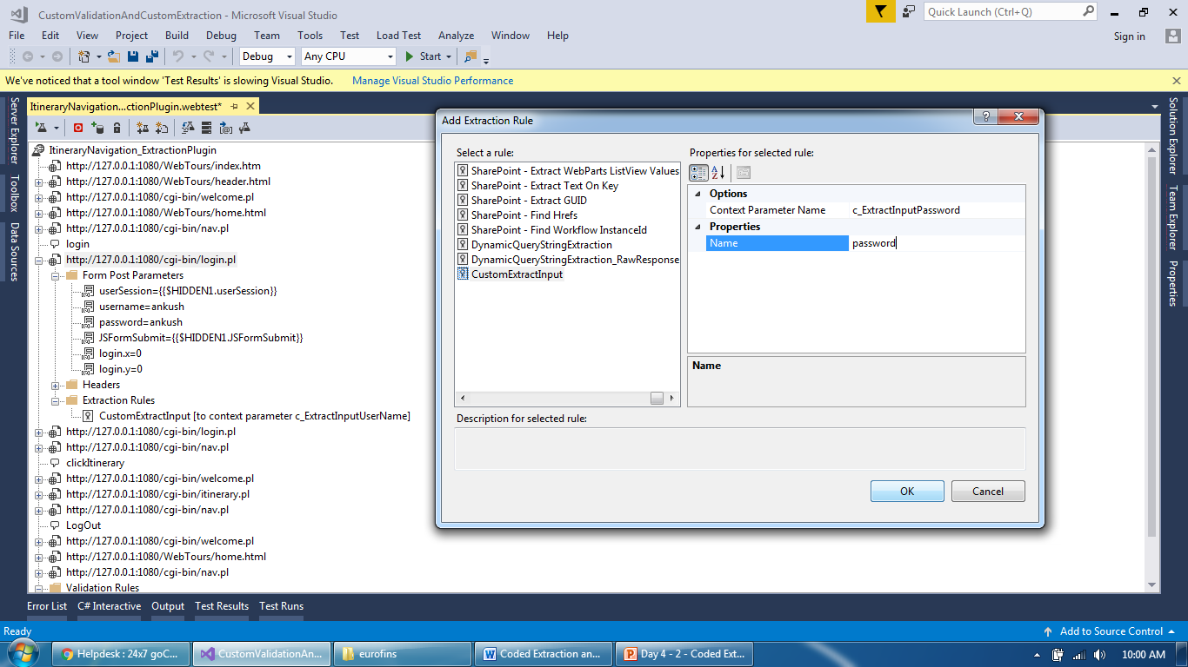
Extraction plugin
Added two extraction rules on a same request

Slide 10
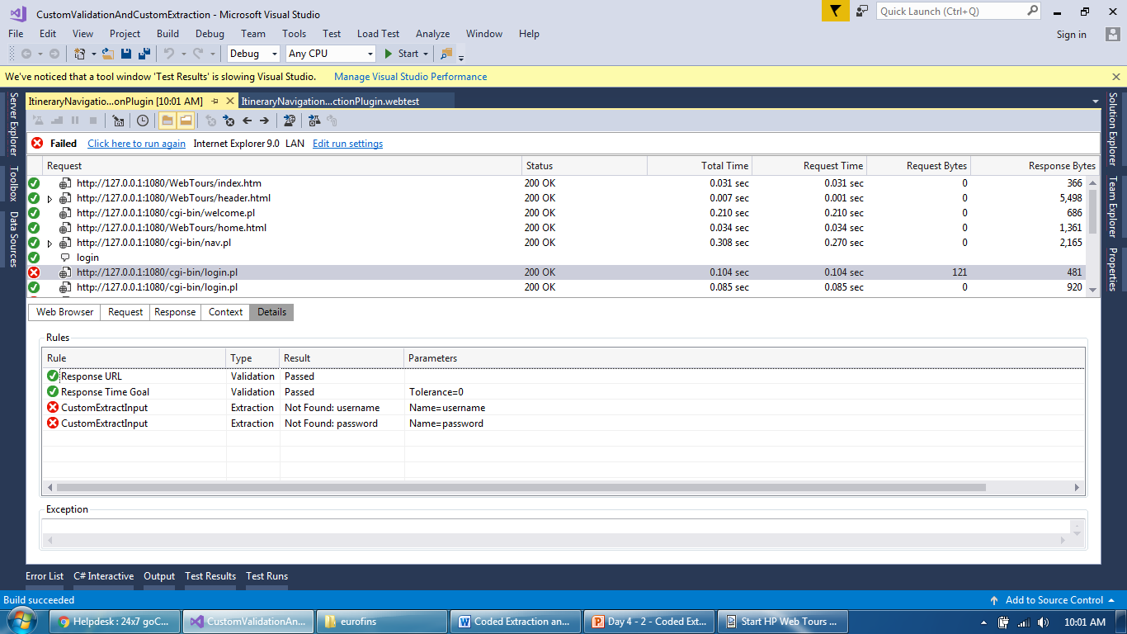
Extraction plugin
Extraction failed as response of that request doesn’t have tag

Slide 11
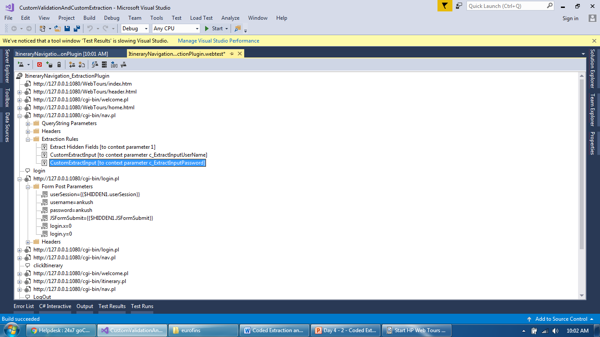
Extraction plugin
Cut and paste to correct request

Slide 12
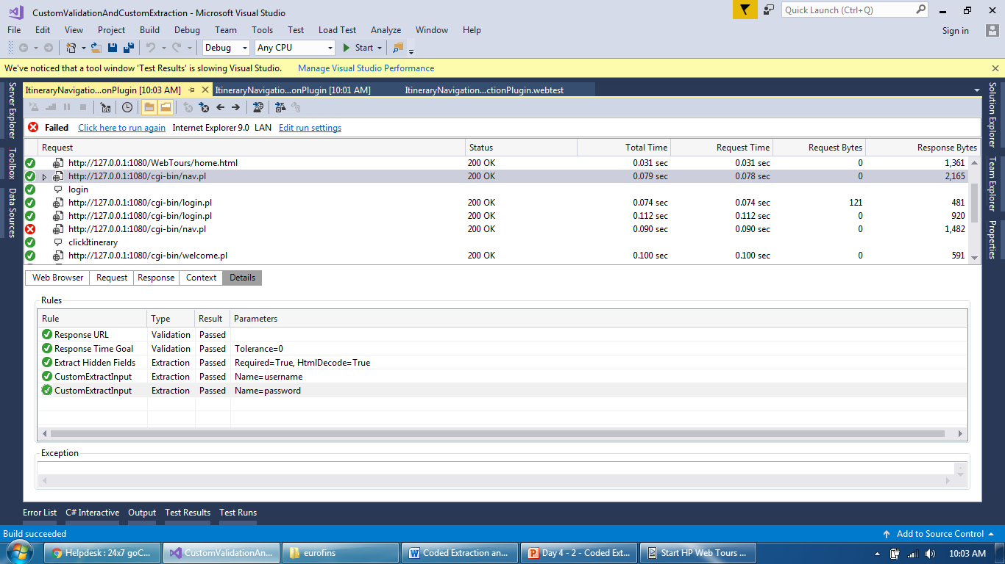
Extraction plugin
Extraction both the values of input tags

Slide 13
Extraction plugin
Sample code for extraction rule based on field name and index
https://blogs.msdn.microsoft.com/joshch/2005/11/17/custom-extractionrule-to-extract-form-fields-by-index/

Slide 14
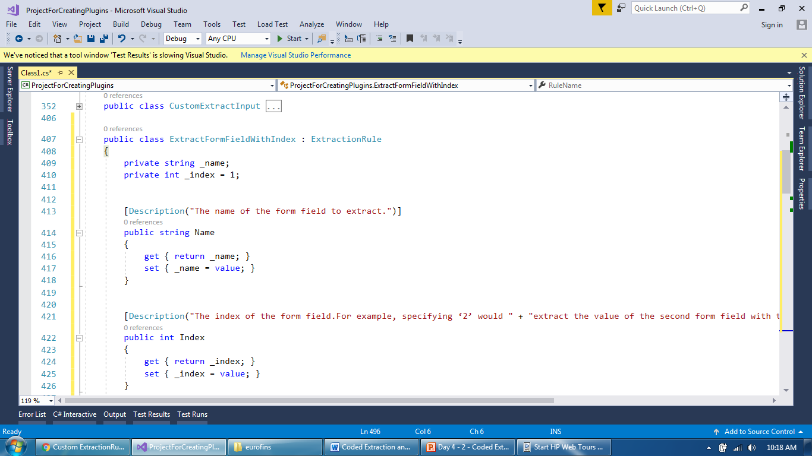
Extraction plugin
Add a new class and extend extraction rule based class

Slide 15
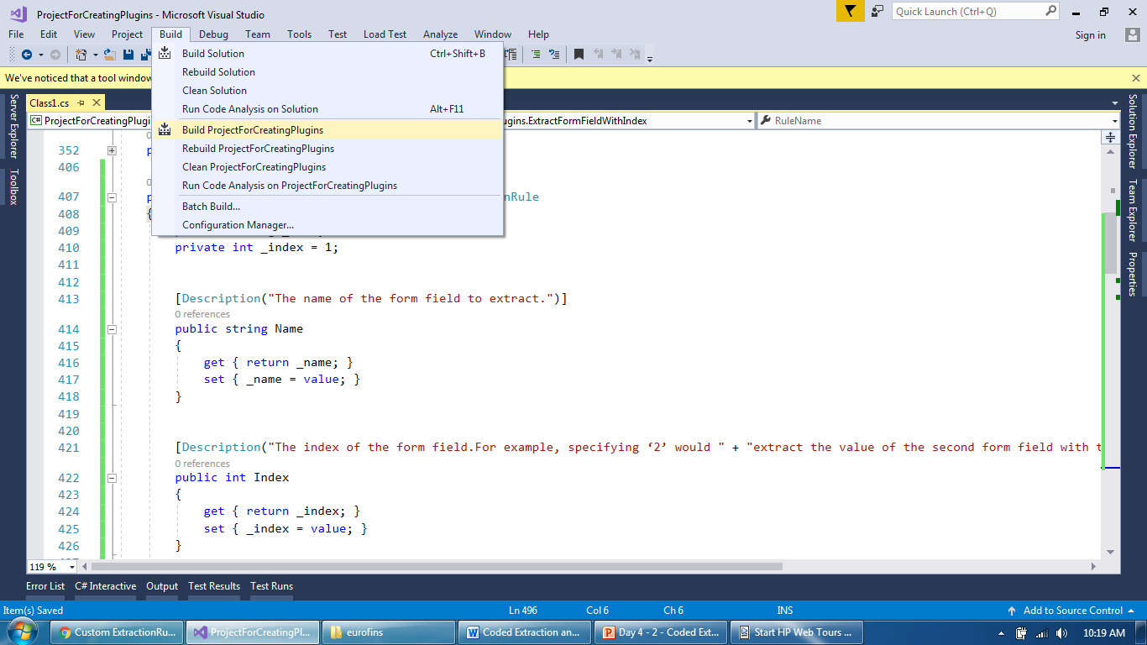
Extraction plugin
Build project to update DLL with new code

Slide 16
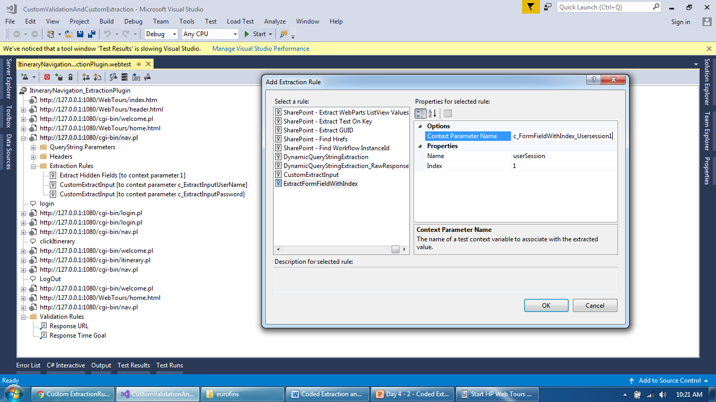
Extraction plugin
Add a userSession with it’s index

Slide 17
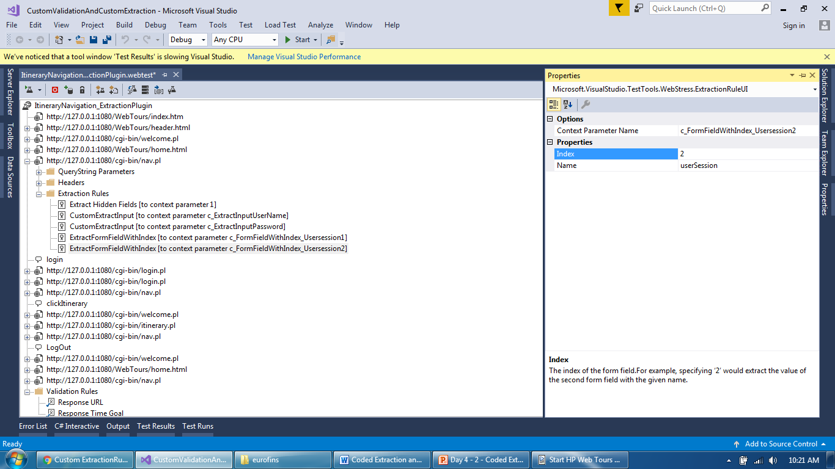
Extraction plugin
Added two extraction rule and it’s parameters

Slide 18
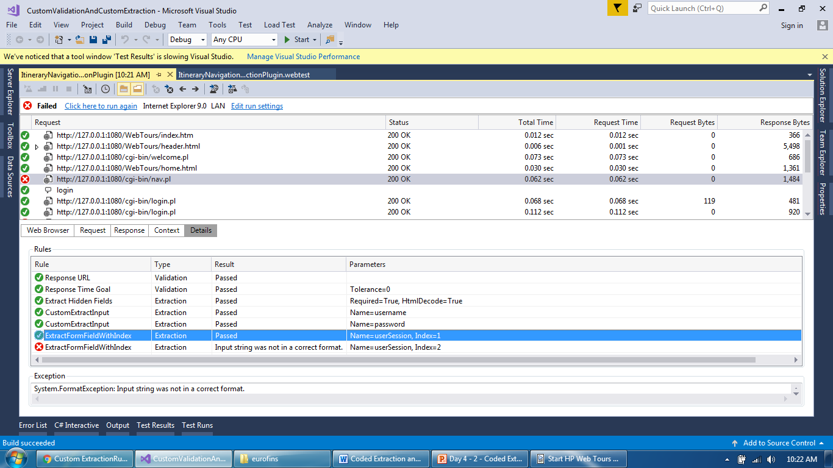
Extraction plugin
One failed and one passed as only 1 value of usersession exists

Slide 19
Extraction plugin
WebTestRecorder plugin to add extraction rule after recording, to be added:
https://msdn.microsoft.com/en-us/library/ff400224.aspx
Validation to be added
https://blogs.msdn.microsoft.com/joshch/2005/11/02/a-custom-validationrule-to-catch-redirects-to-error-pages/
Load Test plugin (to be added but first check if smtp service working or not):
https://msdn.microsoft.com/en-us/library/ms243153.aspx
Another example of custom validation (to be added):
https://msdn.microsoft.com/en-us/library/ms182556.aspx?f=255&MSPPError=-2147217396

Slide 20
Extraction plugin
Debugging in Web Extractor Rule

Slide 21
Thank You

